Slide 1
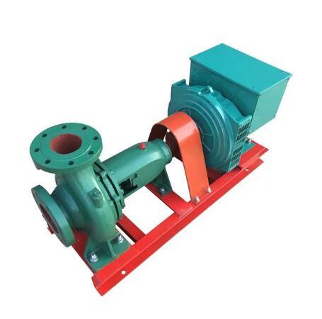
PROJECT MHEP
OFF-GRID POWER
EGERTON UNIVERSITY
dominic.kata@studentpartner.com

Slide 2






POWER
We set up mini hydro power plants
INNOVATE
We think of better ways to do with the power generated.
EMPLOY
OUR
OBJECTIVES
Job opportunities are created while setting up the plants, distributing power and workshops.
AGRICULTURE
Most of the power produced is utilized in the farms.
CONSERVE
This energy source is clean, green and renewable

Slide 3



v
OUR
PARTNERS
EUTEEC
Know-how
www.euteechub.cf
EGERTON UNIVERSITY
GDC
Consultation
Facilitation
Project MHEP

Slide 4
OUR TEAMS
01
Design
02
Mechanical & Mechatronics
03
IT
04
Quality Assurance
05
Electrical & Control
06
Business & Marketing
07
Civil & Environment
08
Welfare & Public Relations

Slide 5
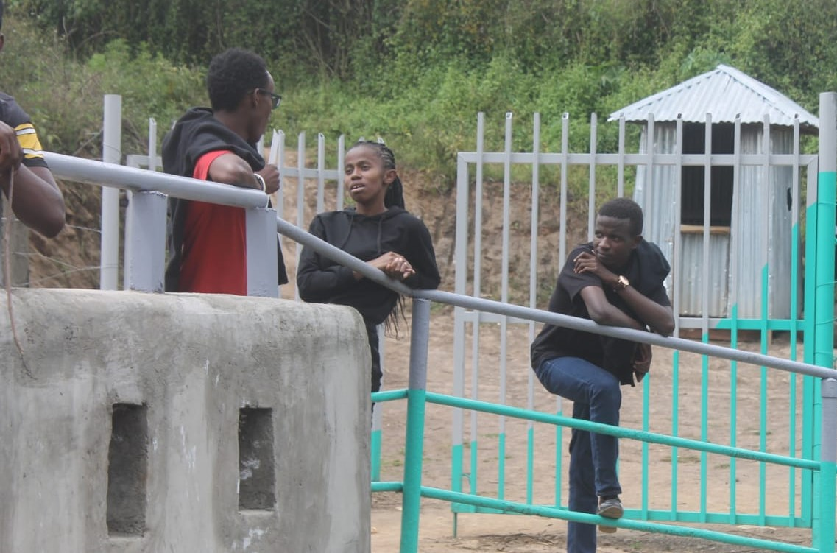
FEASIBILITY STUDY
9TH NOVEMBER 2019
R.NDARUGU
4 Potential Sites located
Over 80 KV expected
Notes:
Watch video here: https://youtu.be/QPad6peRMh0

Slide 6
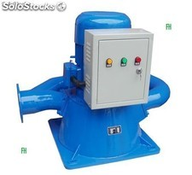

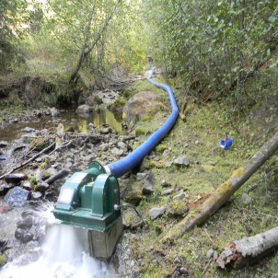

WHY MHEP
Works
Has been used by thousands across the world
Free
DIY
Green
We have free access to rivers and falls with great potential.
Communities can set up and run this technology in their locations by themselves.
This energy is clean and environmental-friendly.

Slide 7
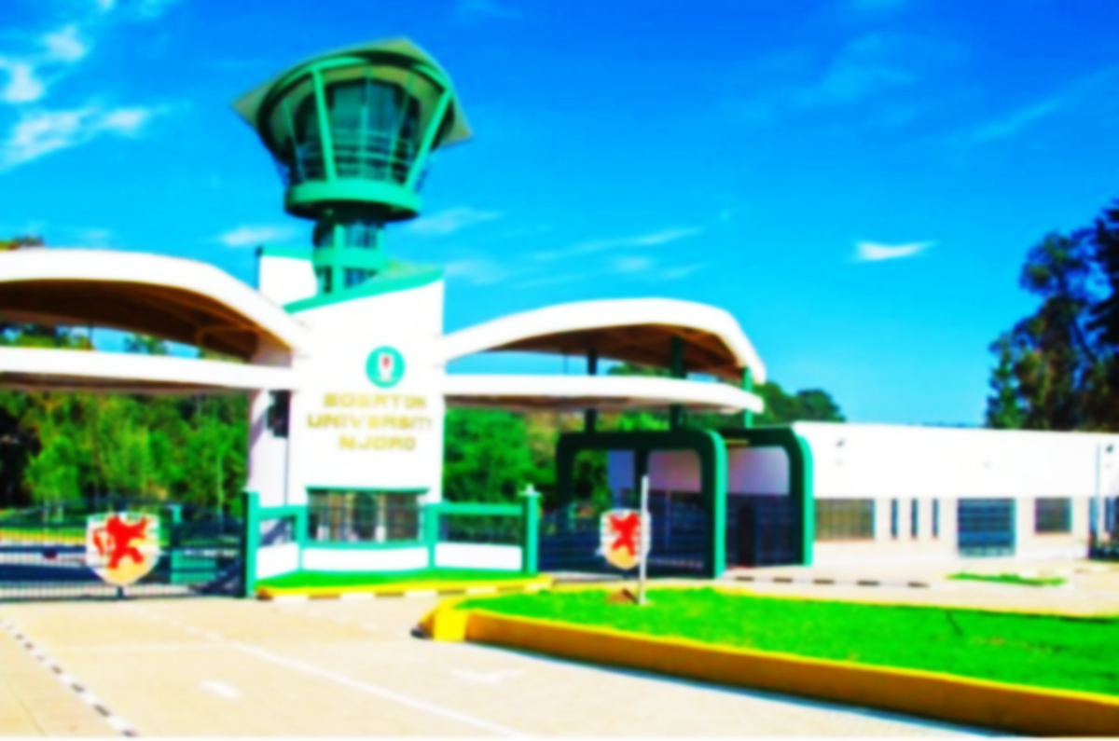
How this power can be used
HEATING
Students can enjoy free hot water in their showers 24/7.
PUMPING & IRRIGATION
To the community, farms and residentials.
LIGHTING
Hostels, Labs ,streets and corridors .

Slide 8
OUR CHALLENGES
01
Political
Factors
SPECIAL REGARDS TO:
02
ENG. JOHN MWITI
MR. KOBIA MUCHEKE
DR.MANENE
ALL MEMBERS OF MHEP FORUM
Technological
Factors
Economical
Factors
04
Social
Factors
03

Slide 9

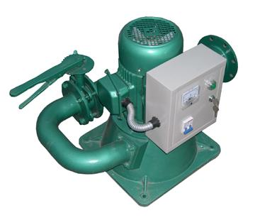
Support us
v
THANK YOU
Check us at
www.mhep.epizy.com

